Slide 1
SMART SOIL TESTING KIT
College: PUNE INSTITUTE OF COMPUTER TECHNOLOGY
Team ID: 292
Member 1: Soham Deshpande, 2nd year engineering student at Pune Institute of Computer Technology. Beginner in Data Science and Django Backend development.
Member 2: Romank Sadhwani, 2nd-year student at Pune Institute of Computer Technology. Beginner in phpMyAdmin, MySQL, Data Science, Microsoft Certified for Azure AI Fundamentals. Curious to learn new technologies.
Member 3: Shrihari Kulkarni, 2nd year student at Pune Institute of Computer Technology. Beginner in VLSI Designing. Have a pretty decent knowledge of Embedded Systems, IoT, and PCB Designing.
Member 4: Prasad Chaudhari, 2nd year student at Pune Institute of Computer Technology. Beginner in ML and have a decent knowledge of MySQL, PHP, HTML, and CSS.

Slide 2
PROBLEM STATEMENT
Through generational knowledge, the Indian farmer is extremely perceptive and knowledgeable. However, the crop yield of the Indian Farmer is still affected due to the inability to integrate the generation knowledge with modern techniques and Products Synthesized from modern scientific methods(MSM) such as GMCs, which is justifiably understandable. There is a need for a suggestion model that considers these dynamic parameters and gives suggestions throughout the agricultural process.

Slide 3
PROPOSED SOLUTION
Our product is a cheap, easy-to-use soil parameter tester that communicates this data with our online portal which uses a trained ML model to continuously provide suggestions for the agricultural process to make the process sustainable.

Slide 4
TARGET MARKET
We will use the following channels to get to this market:
Farmers across various places in the country.
Government agencies.
Horticulture and the Gardening sector.
Word of mouth.
Complimentary kits and Educational services

Slide 5
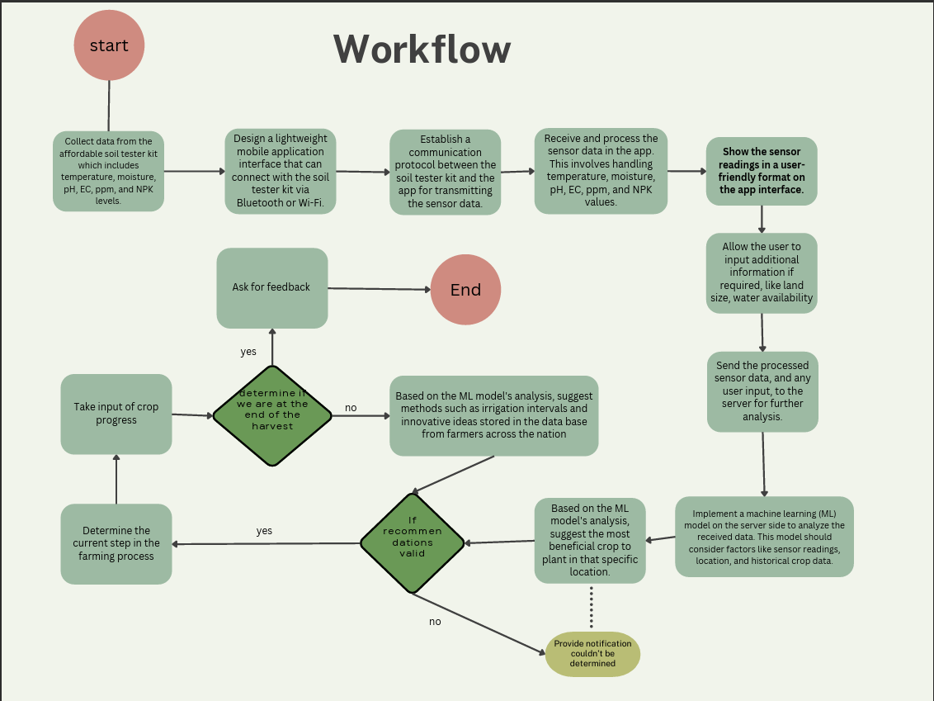
FLOWCHART

Slide 6
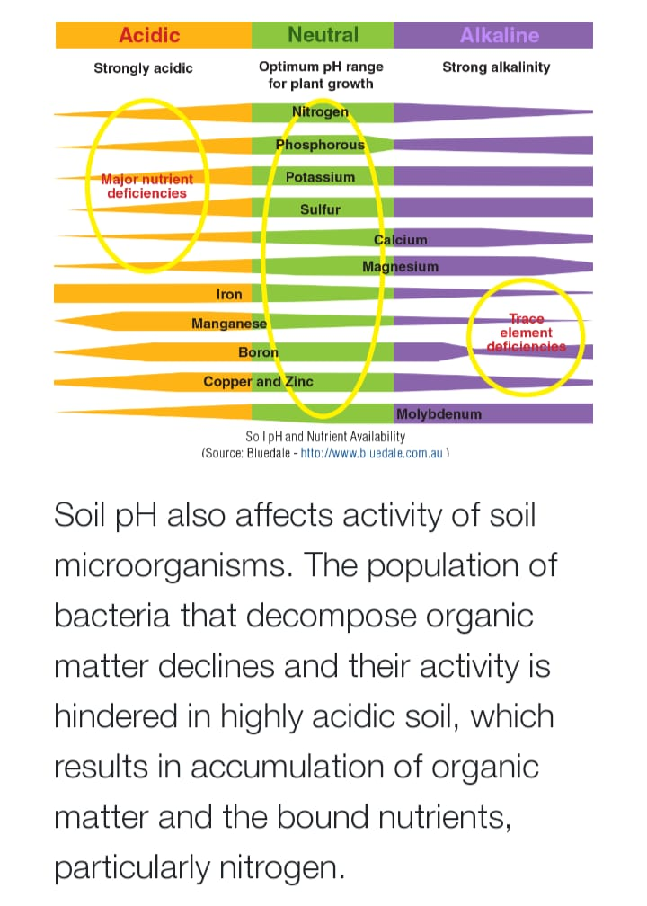
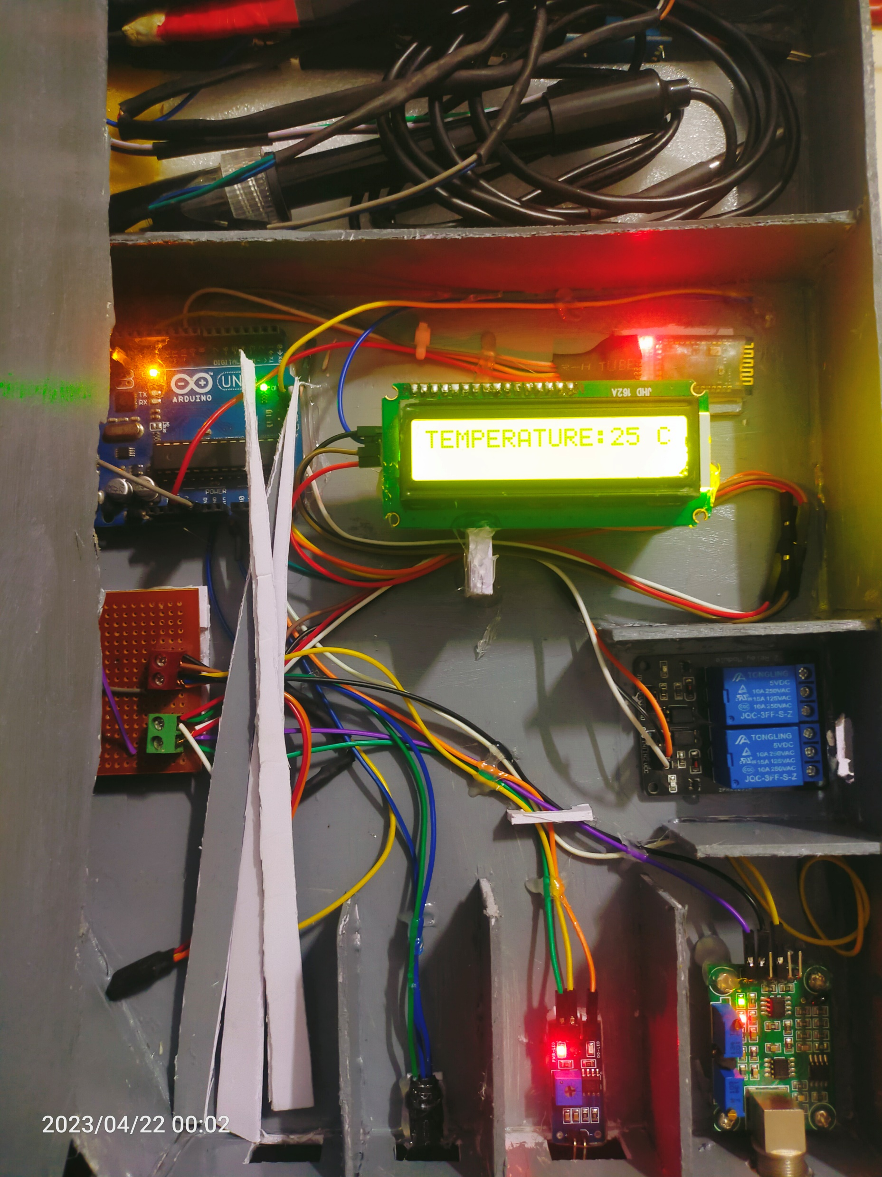
photos

Slide 7
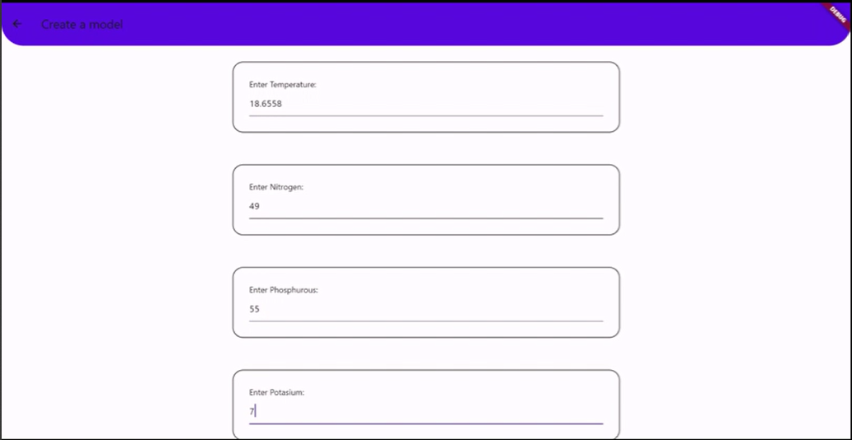

Slide 8
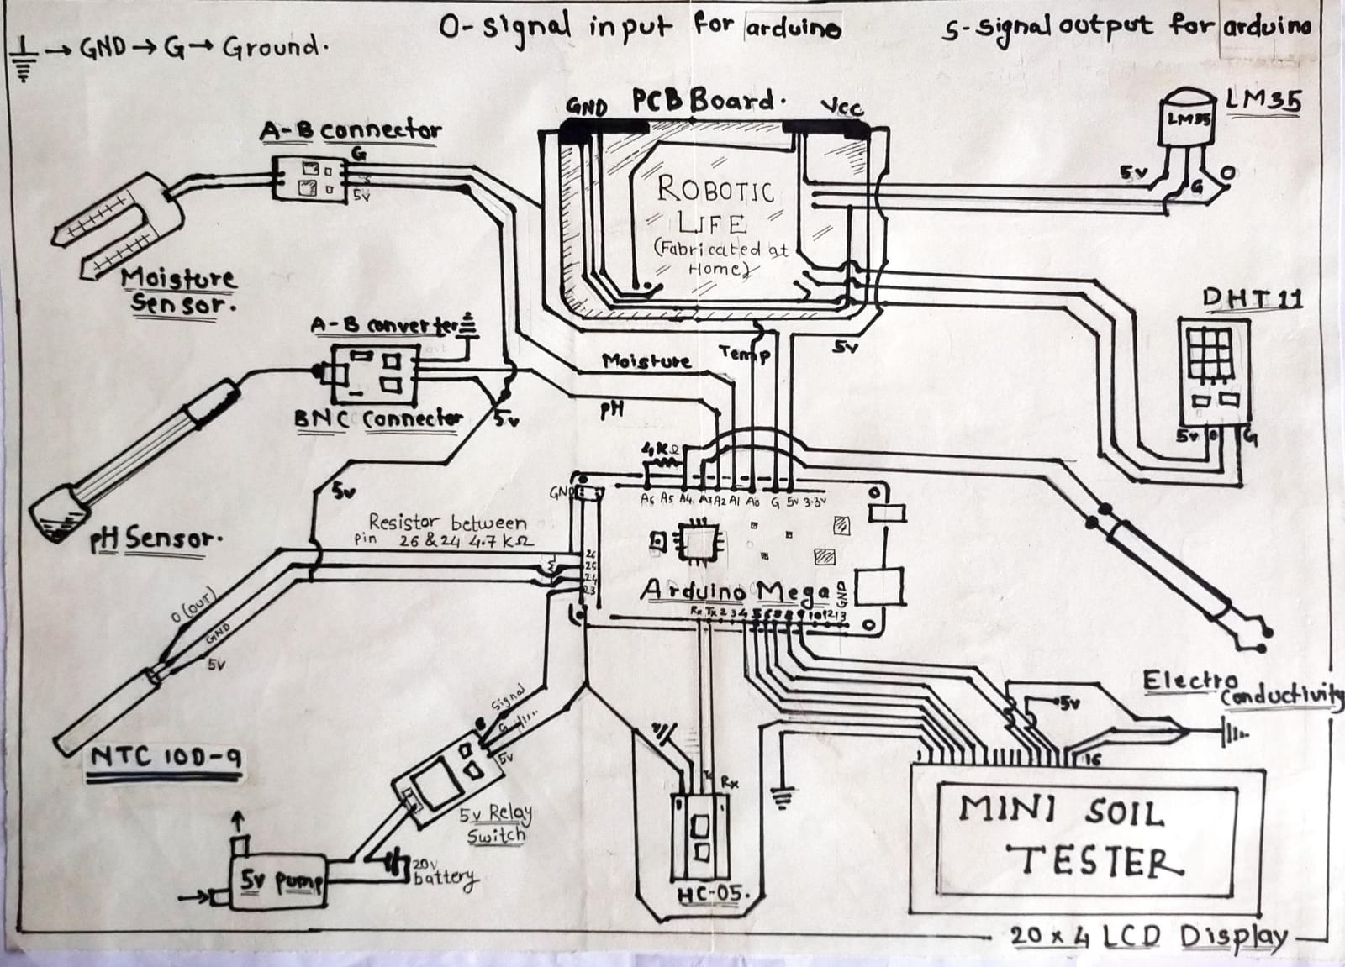

Slide 9
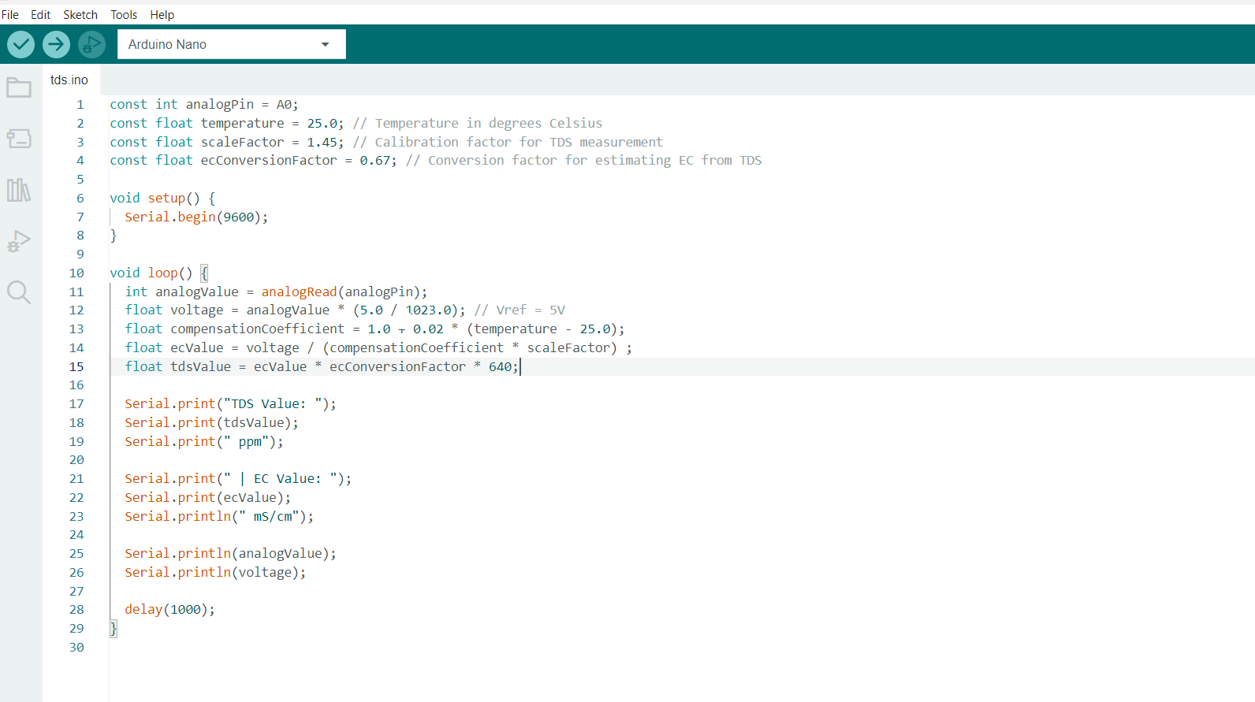

Slide 10
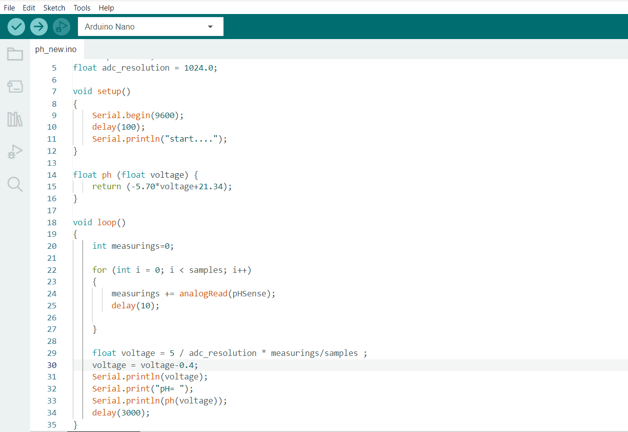

Slide 11
TO DO LIST
Hardware:
1. Sensor calibration
2. Change of microcontroller board
3. Communication modes
Software:
1. UI
2. Software and hardware communication mode
3. Language
Better USP(unique selling proposition)
FIELD VISIT.

